Slide 1
Digital Image Processing Experiment Description2
Guohao Li
lcliguohao@163.com

Slide 2
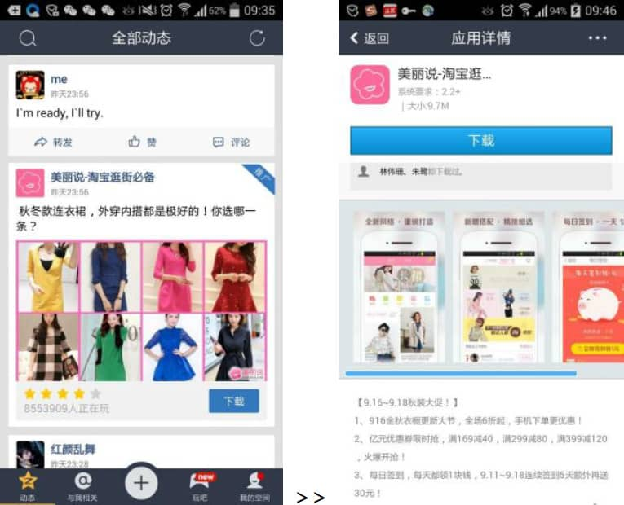
Task – Ad Positive/Negative Feedback Prediction
Notes:
描述任务：预测QQ空间消息流中广告的正负反馈。
QQ空间中消息流广告的感性认识，展示页，落地页，曝光，正反馈，负反馈
广告构成：文字、图片、还会给用户属性，广告属性，曝光时间等等
目标：预测用户的反馈行为

Slide 3
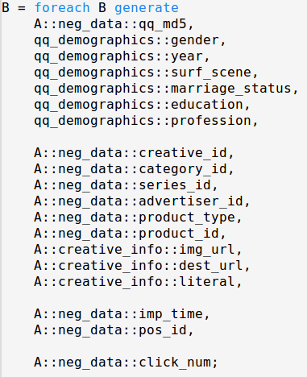
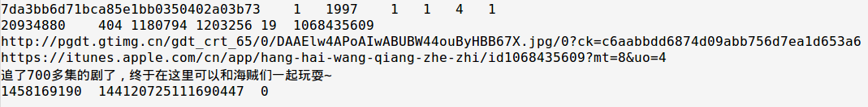
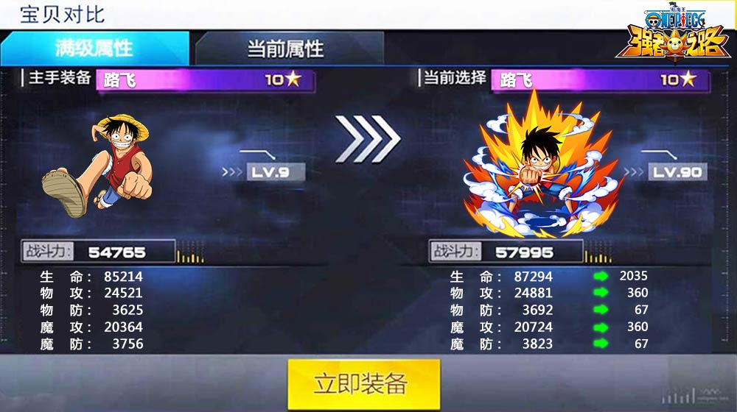
QQ Space Ad data format - demo
Notes:
介绍数据格式
右侧是数据中全部的字段
左侧是数据集中的一条真实的数据

Slide 4
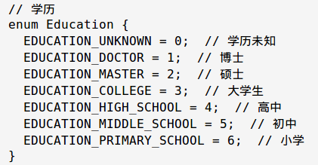
QQ Space Ad data format – user attributes
qq_md5
gender
year
surf_scene
marriage_status
education
profession
See user.proto for more
Notes:
QQ号做了md5加密；year为出生年份；其余的用户属性的枚举值含义在user proto文件中，将作为附件一并上传

Slide 5
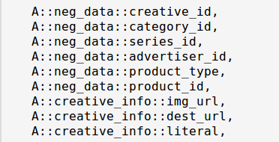
QQ Space Ad data format – ad ids
Advertiser ID
Series ID
Product ID
Product Type
Category ID
Creative ID
URL
literal
Notes:
广告的树状层次，不同的ID和属性分属不同的层次，如左图所示
广告主 – 广告系列 – 广告商品（id可能为空） - 广告创意
广告商品类型是枚举值，含义如右图所示
广告创意为最细粒度，和图片、文字为一一对应的关系
Image url是广告图片的下载链接
Dest url是落地页的链接

Slide 6
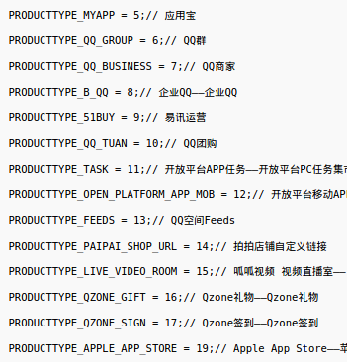
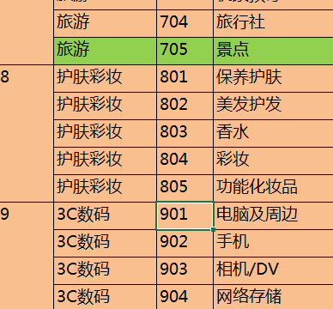
QQ Space Ad data format – ad attributes
Category id
@‘广告主行业准入规则.xlsx’
Product type
@producttype.png
Image url
url for downloading
Destination url
jump after click
Category ID
Product Type

Slide 7
QQ Space Ad data format – ad context
imp_time: exposure time
Unix time
pos_id: 4 values only
72063131073762511 / 144120725111690447
216178319149618383 / 288235913187546319
click_num:
0: negative feedback
1: positive feedback

Slide 8
QQ Space Ad data format – dataset
Train dataset
11w, UTF8 Unicode text
Balanced
Test dataset
5w
click_num removed
submit your prediction result
Image dataset
images in train/test dataset.

Slide 9
Basic methods. for reference only
Logistic regression
SVM
Extract text features? Image features?

Slide 10
Experimental requirements
Group work
Each group has 4 students
About 10 groups
Presentation
In class. week16
5~8 min each group
Files you need to submit
Everyone needs to submit a report
Your code
Result file of your prediction for test dataset. (one number per line)

Slide 11
Experimental requirements
Evaluation
Prediction results accuracy 30% (group work, evaluated by TA)
Idea, innovation 30% (group work, based on presentation)
Quantity of work 40% (individual, based on your report)
Please do not distribute these datasets/files. Use in class only.

Slide 12
Finally
本实验的最终解释权归崔老师和助教所有。
Questions are welcome.

